Slide 1
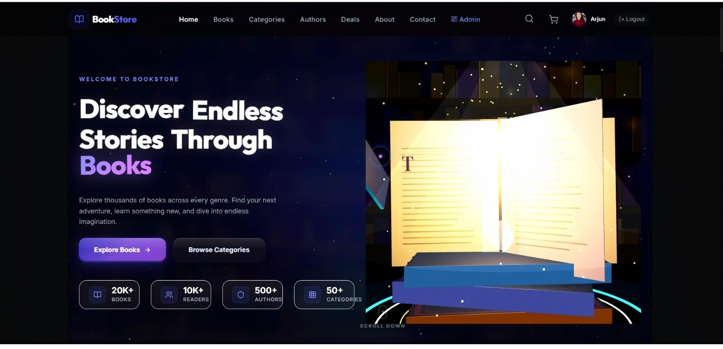
Homepage
1

Slide 2
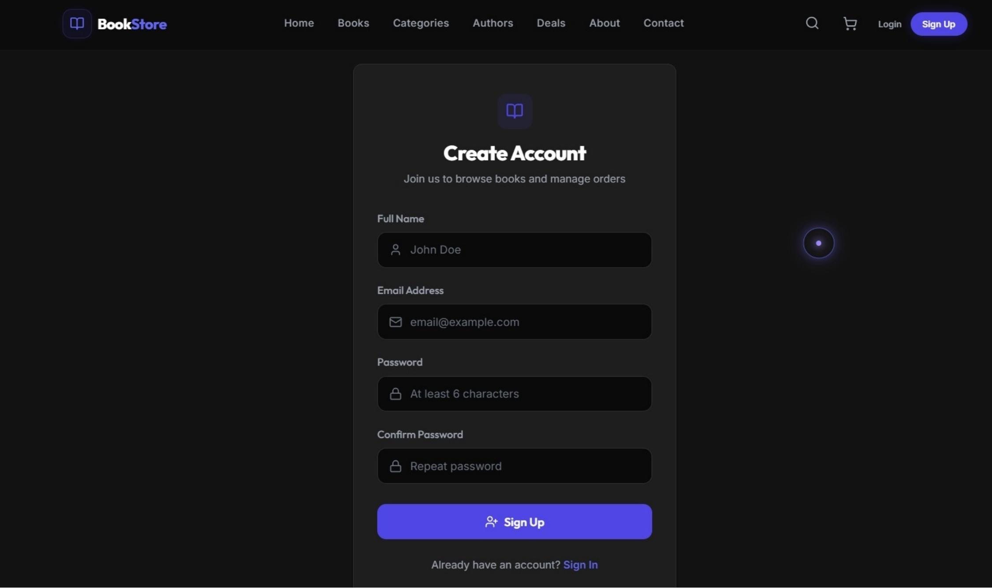
Admin Registration
2

Slide 3
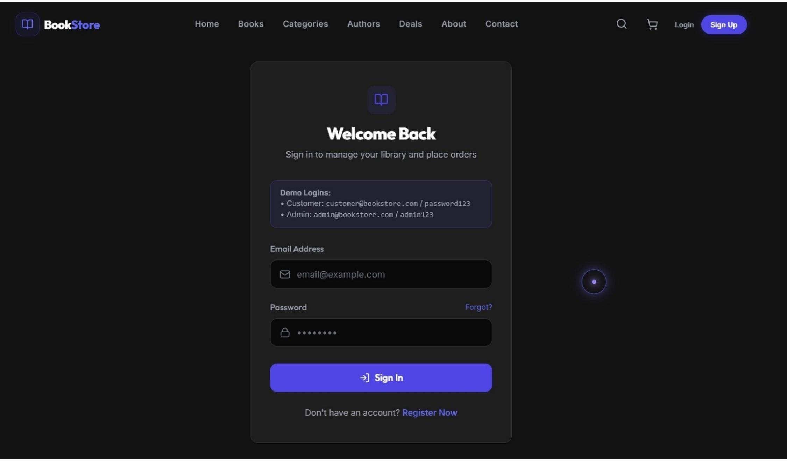
Admin Login
3

Slide 4
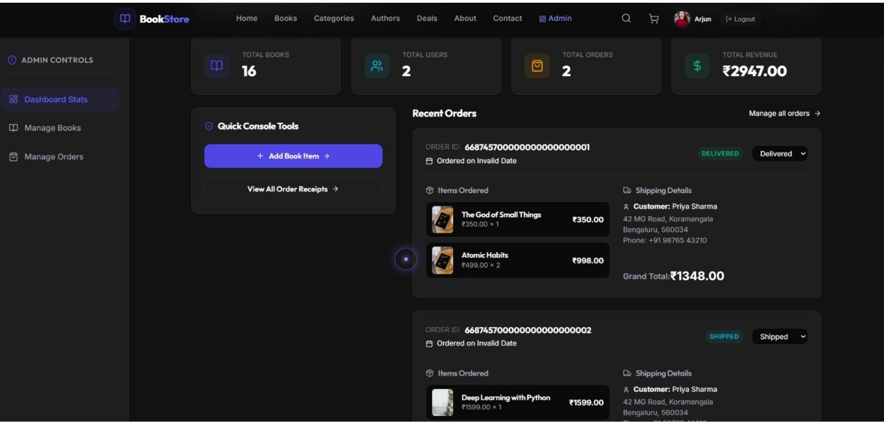
Admin Home
4

Slide 5
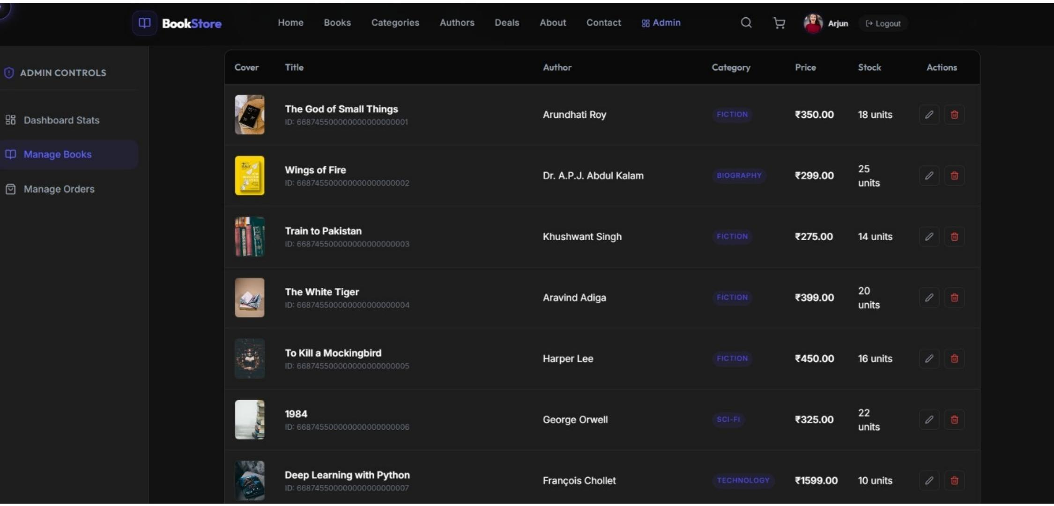
Admin Manage Books
5

Slide 6
Seller Registration
6

Slide 7
Seller Login
7

Slide 8
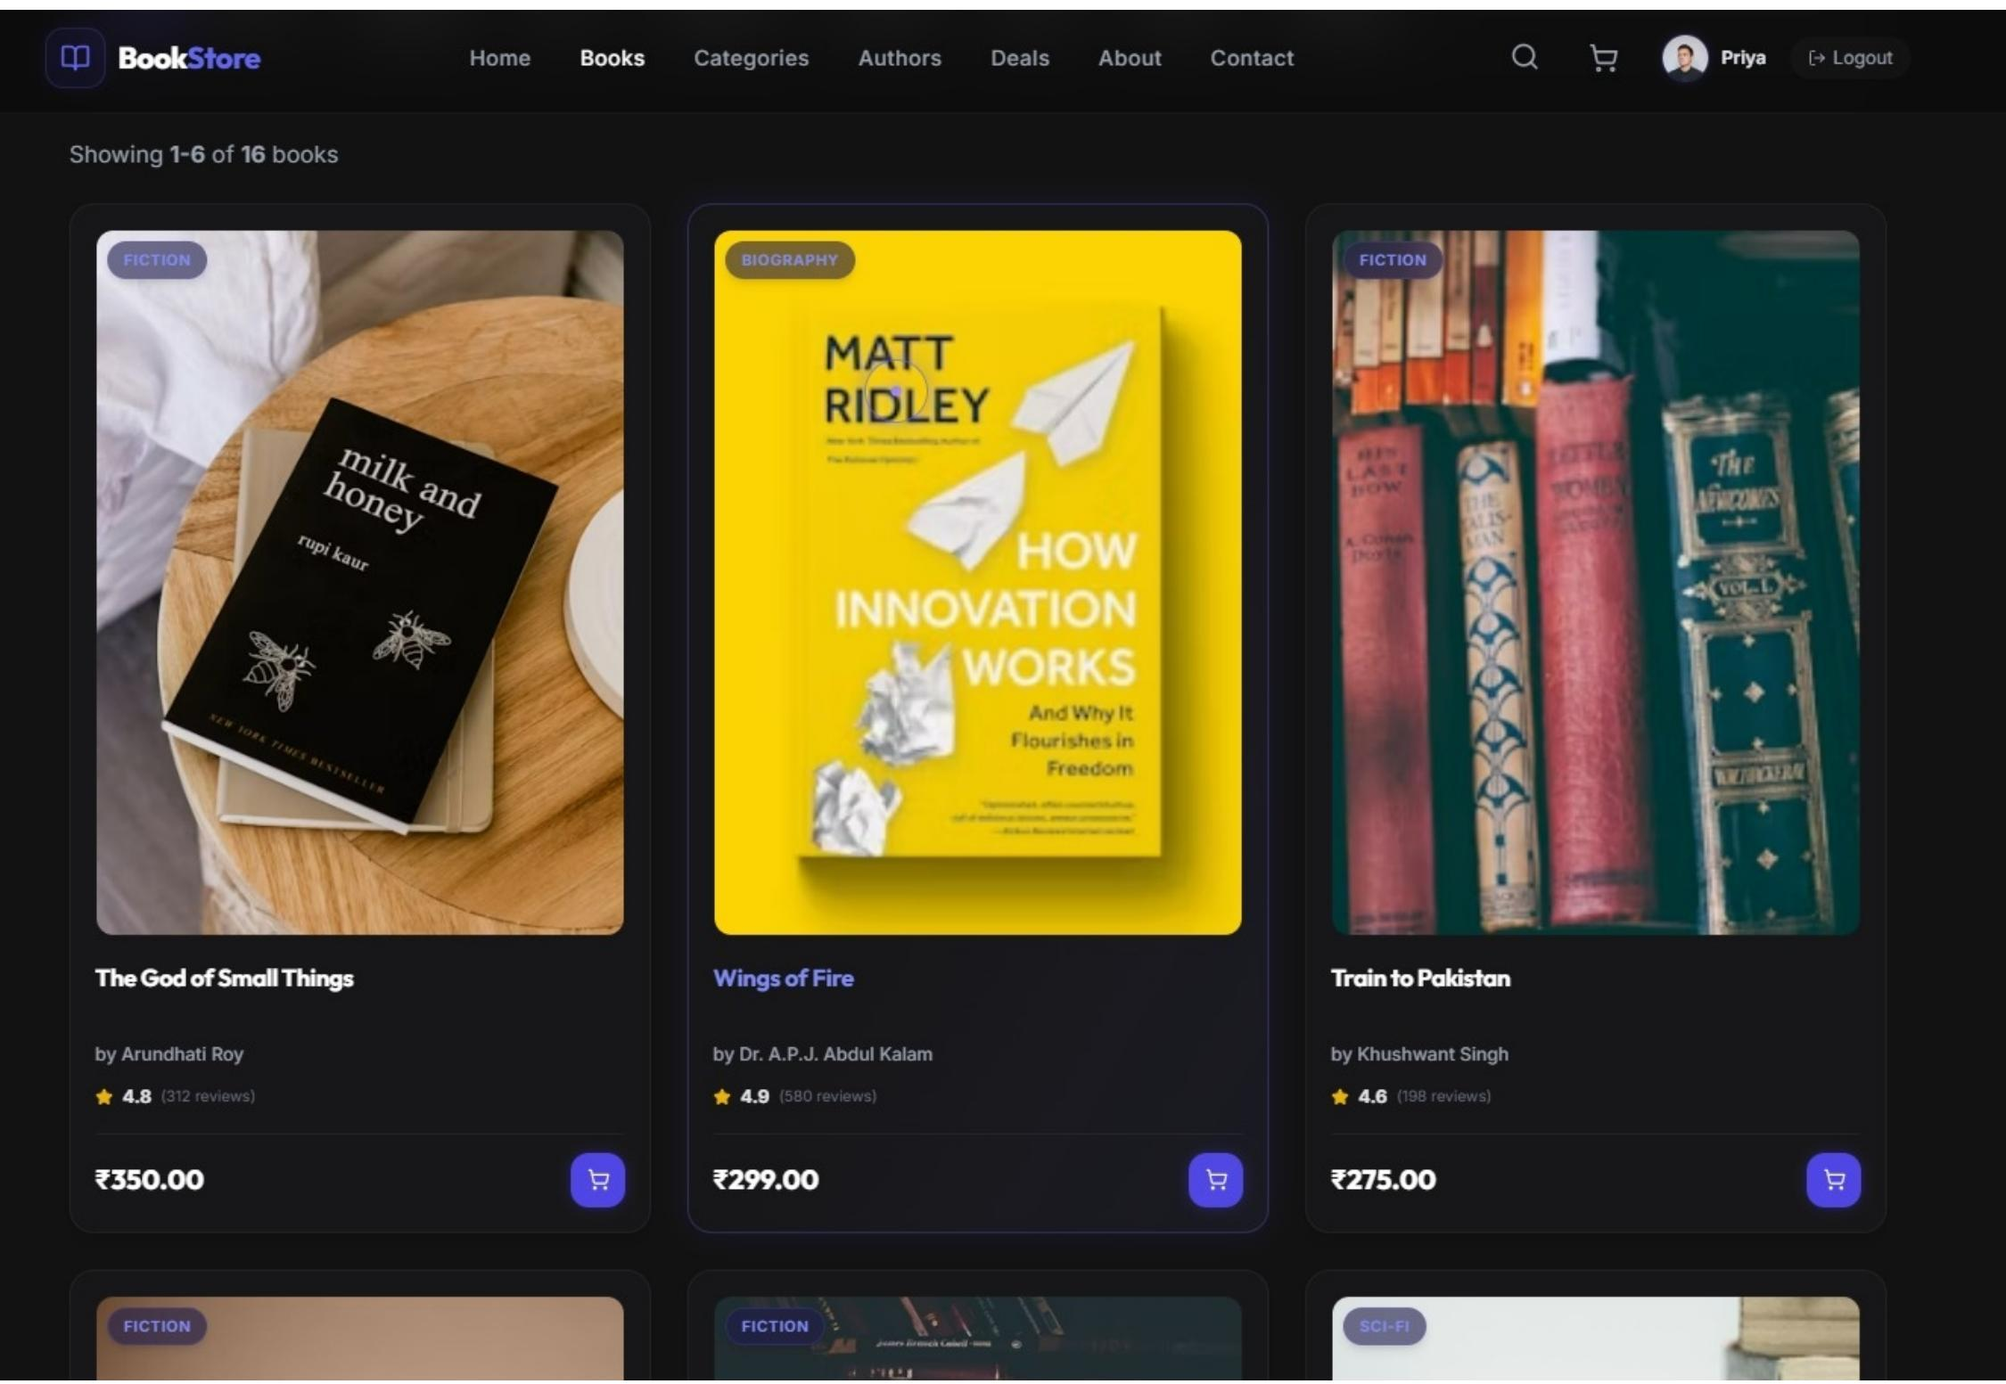
Seller Products
8

Slide 9
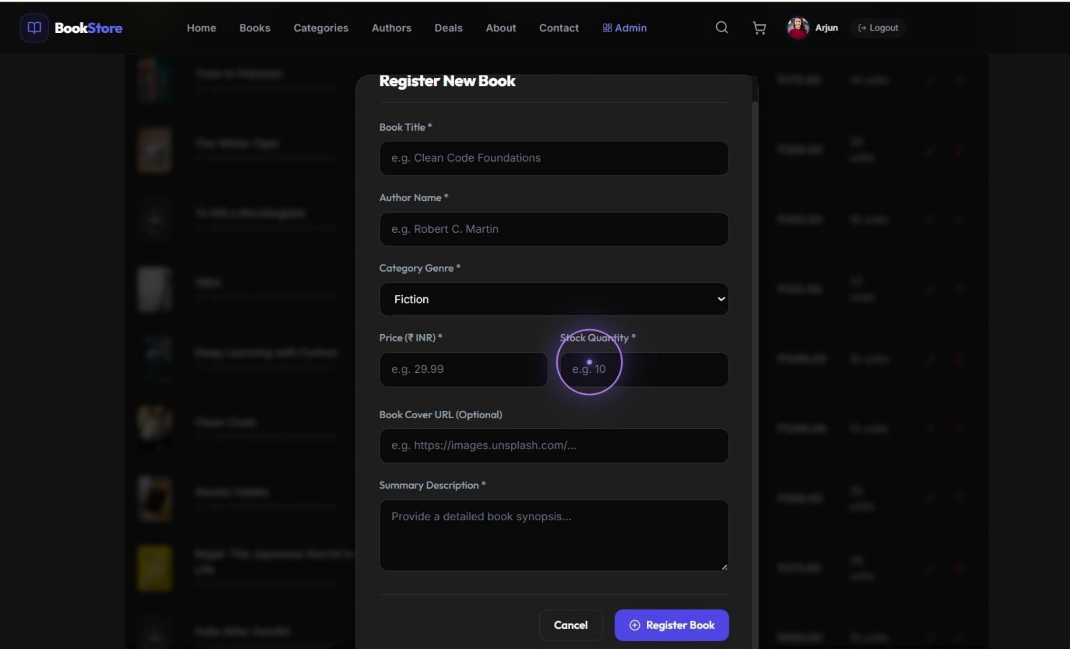
Add Book Page
9

Slide 10
Order Page
10

Slide 11
User Registration
11

Slide 12
User Login
12

Slide 13
Users Homepage
13

Slide 14
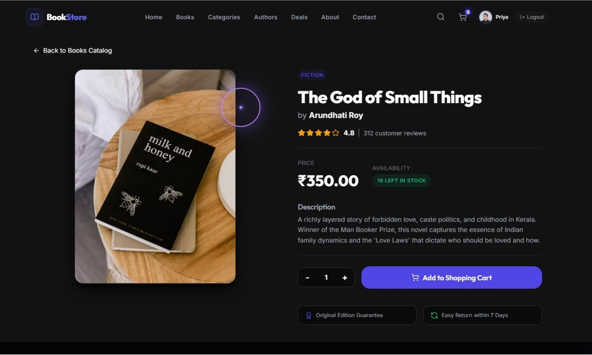
BookView Page
14

Slide 15
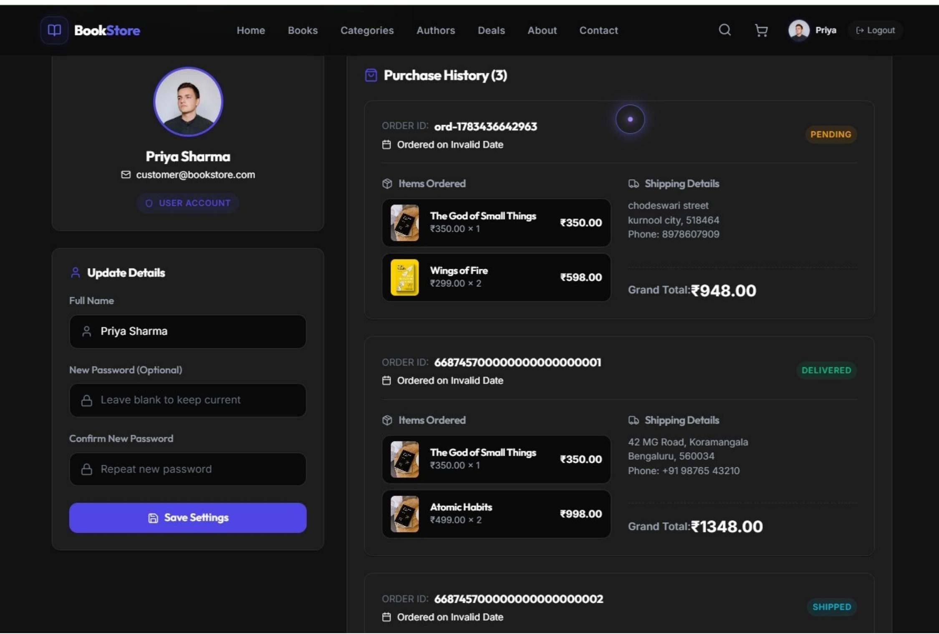
Orders History
15

